Slide 1

State Data
Use and Needs
Survey
Work in Progress
Marijke van der Geer, Jianing Cai,
Data Science for the Public Good (DSPG) Interns
Treena Goswami, SDAD Post-doc
Vicki Lancaster, DSPG Team Lead
Social and Decision Analytics Division
July 13, 2023

Slide 2
Project Team
DSPG, University of Virginia, Biocomplexity Institute, Social and Decision Analytics
Marijke van der Geer, Fourth Year @ SDSU (Stats & DS)
Jianing Cai, Fourth Year @ UVA (CS & Math)
University of Virginia, Biocomplexity Institute, Social and Decision Analytics
Vicki Lancaster, Principal Scientist
Neil Kattampallil, Research Scientist
Treena Goswami, Postdoc Researcher

Slide 3
Project Goals
To provide the Census Bureau with information on the following.
What data sources do state, U.S. territories, and District of Columbia, data centers use?
How do they use these data sources?
What are their future data needs?

Slide 4
Our ideas:
Text analysis of state constitutions and amendments
Evaluation of state, U.S. territories, and District of Columbia data centers
Text analysis of state data center mission statements
Email survey sent to all 56 FSCPE contacts
Search of UVA library databases: Policy Commons Database
  Policy File Index Database, State and Local Government Databases. Policy Map Customer Stories

Slide 5
Idea 1: Text analysis of state constitutions and amendments
Manual Search
Computer Search (Topic Modeling)
  Gensim
  BERT

Slide 6
Manual Search
Idea 1: Text analysis of state constitutions and amendments
Collected constitutions and amendments
  Converted .pdf to .txt files
Searched 2 constitutions each for key words
  Data, census, information, etc.
Looked for adjectives that could be "tested" by data
  Minimum, maximum, annual, etc.

Slide 7
Computer Search
Idea 1: Text analysis of state constitutions and amendments
In statistics and natural language processing, a topic model is a type of statistical model for discovering the abstract "topics" that occur in a collection of documents.
A frequently used text-mining tool for discovery of hidden semantic structures in a text body.
Packages: GENSIM, BERT, NLTK, etc

Slide 8
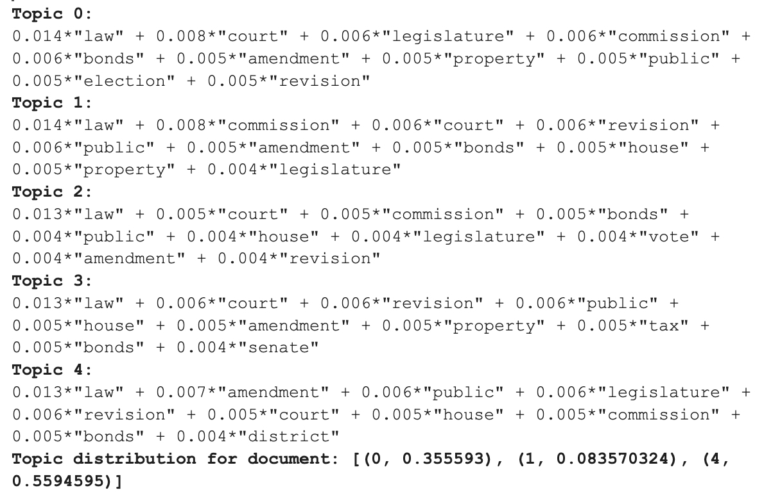
Topic Modeling using GENSIM
Idea 1: Text analysis of state constitutions and amendments
Combine VT, VA, FL state's constitution together
Number of topics to generate can be modified
  Manually excluded words
  Repetitive words and topic group

Slide 9
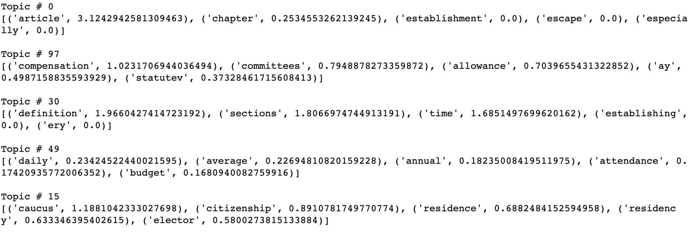
Topic Modeling using BERT
Idea 1: Text analysis of state constitutions and amendments
Example: California
Notes:
Approach 1 Summary
State Constitutions contain only broad topics
Narrow down our focus to State Data Centers

Slide 10
Idea 2: Evaluation of state, U.S. territories, and District of Columbia, data centers
Divided SDCs between team members for a brief review
Classified all SDC data tools and data sources into different categories
  Housing: Units, Vacancies
  Economy: Wage, Employment, Economy
  Demographics: Estimates, Projections
  Diversity: Migration, Race, Ethnicity
Notes:
Final objective: Creation of interactive webpage
Data visualization

Slide 11
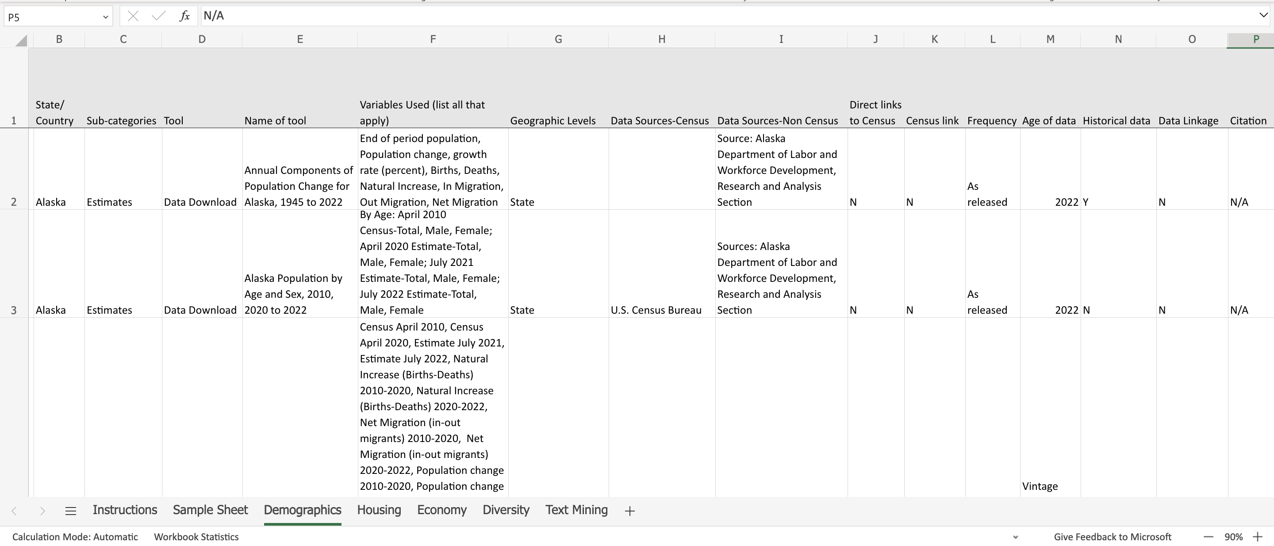
Idea 2: Evaluation of state, U.S. territories, and District of Columbia, data centers

Slide 12
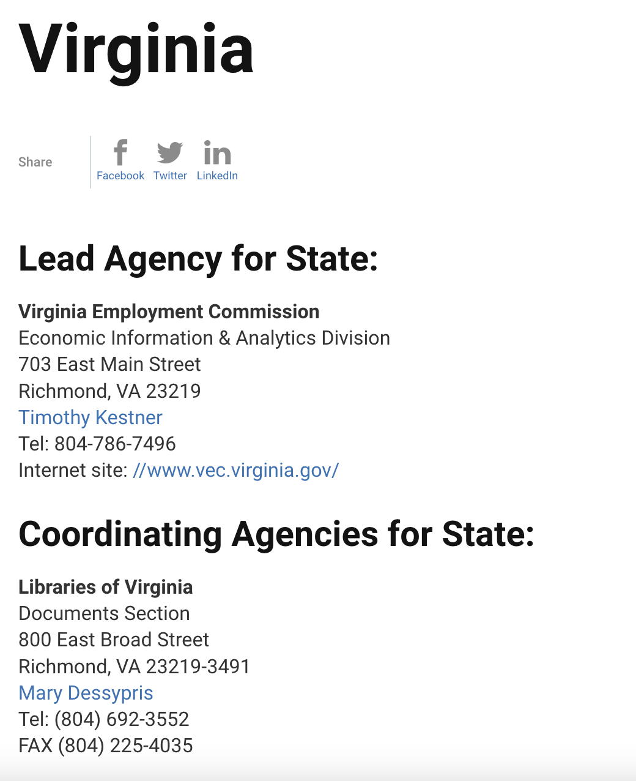



State Data Centers
Idea 2: Evaluation of state, U.S. territories, and District of Columbia, data centers
Lead and coordinating agencies
Numerous types of agencies
  Universities, Libraries, Research Centers
Determined whether sites for state data centers are scrapable

Slide 13
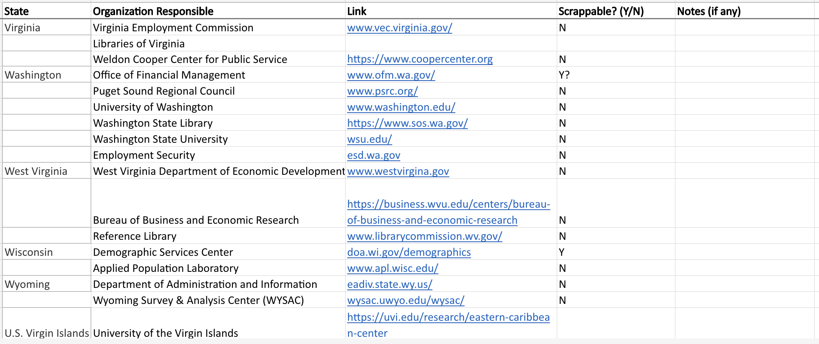
Idea 2: Evaluation of state, U.S. territories, and District of Columbia, data centers

Slide 14
Idea 2: Evaluation of state, U.S. territories, and District of Columbia, data centers

Slide 15
Idea 2: Evaluation of state, U.S. territories, and District of Columbia, data centers

Slide 16
Scrapable Websites
Idea 2: Evaluation of state, U.S. territories, and District of Columbia, data centers
Simplicity
  A page that contains all data sources that being used / data tools that the SDC developed
  No extra weblinks
  Well Organized
    Classified data/tools by different category
    Data source, name, and links are explicitly listed out

Slide 17
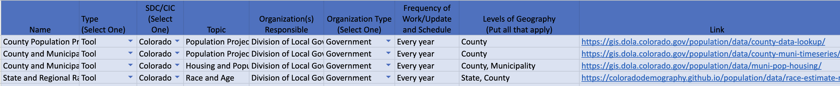
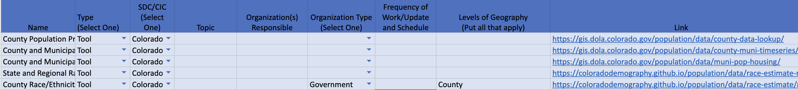
Result Example: Colorado SDC Site
Idea 2: Evaluation of state, U.S. territories, and District of Columbia, data centers
Manual search vs. web scraping
Notes:
Approach 2 Summary:
Collection and initial inspection of SDC links
Analysis on the Colorado state data center
Classify data tools and data sources into different categories

Slide 18
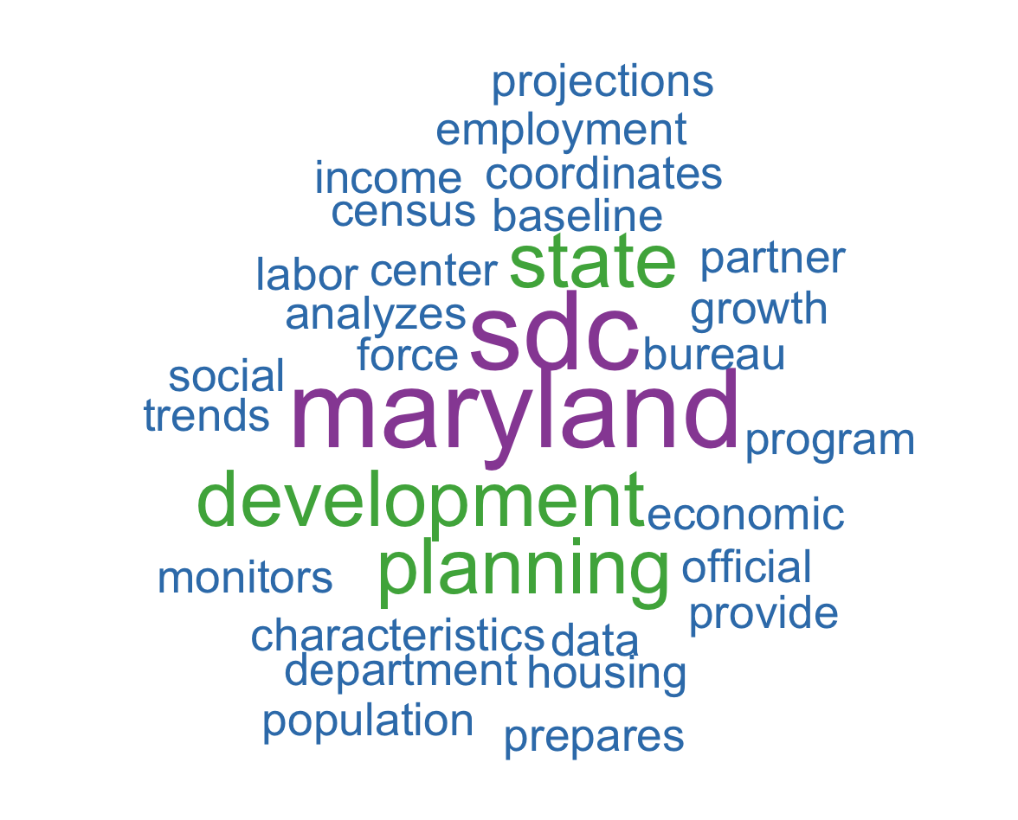
Idea 3: Text analysis of State Data Center mission statements
Collection of SDC mission statements
Word-clouds
  Individual (Maryland) vs. Combination

Slide 19
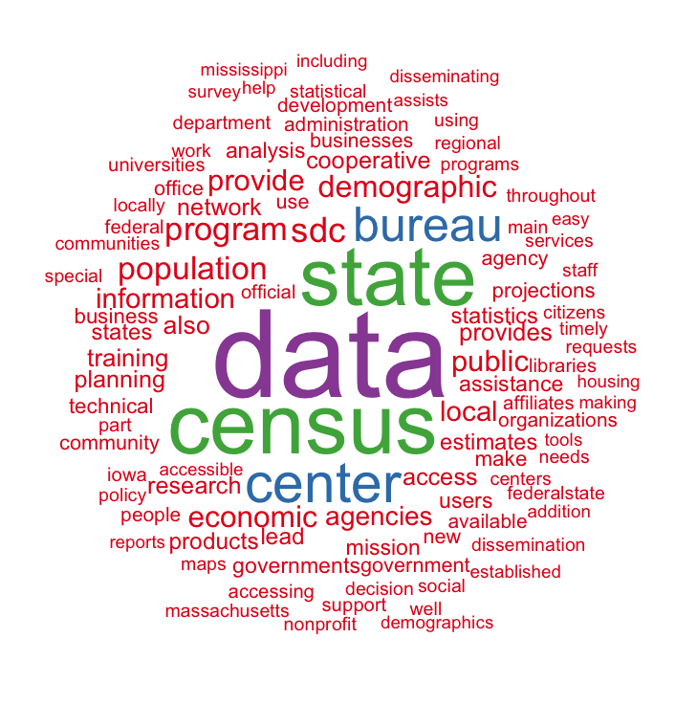
Idea 3: Text analysis of data center mission statements
Combination of 38 SDC mission statements

Slide 20
Idea 4: Email survey sent to all 56 FSCPE contacts
Reached out to all 56 contacts on the Federal-State Cooperative for Population Estimates (FSCPE) website on July 10th
Asked for top 6 priority data applications with their corresponding data sources, a brief description/objective, and related web links
Received 4 replies so far (New York, Virginia, Kansas, and Guam).
Still collecting responses...

Slide 21
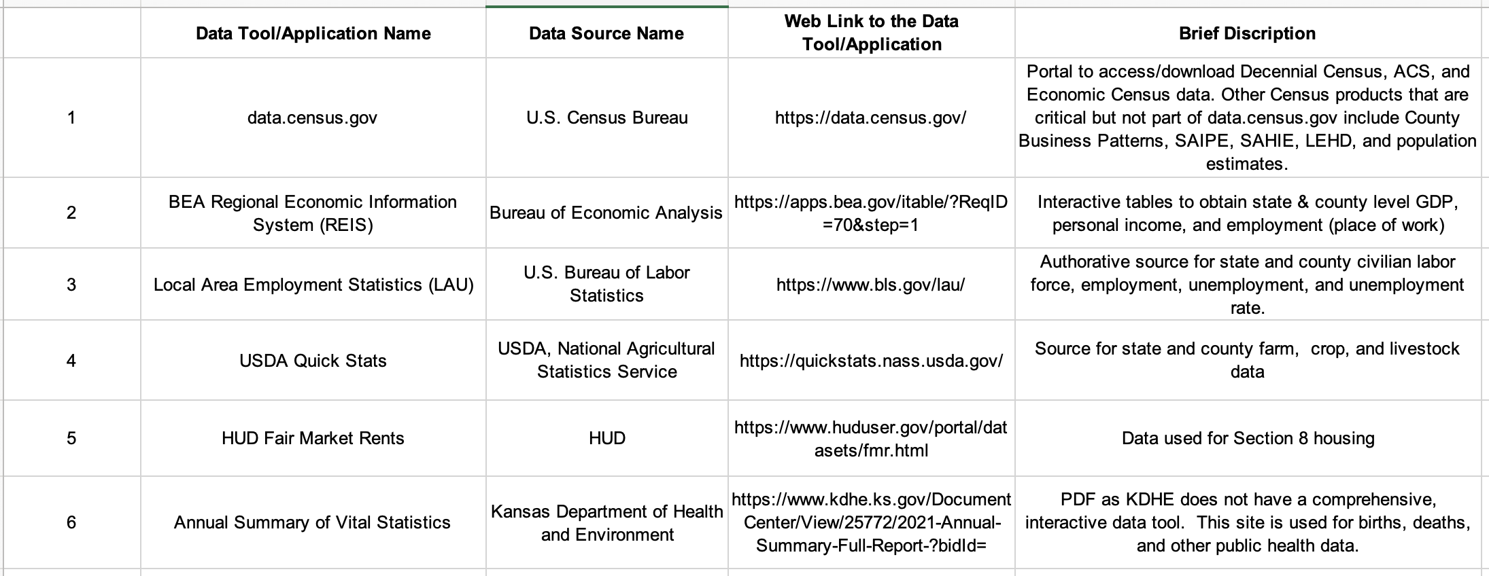
Kansas FSCPE Responses
Idea 4: Email survey sent to all 56 FSCPE contacts

Slide 22
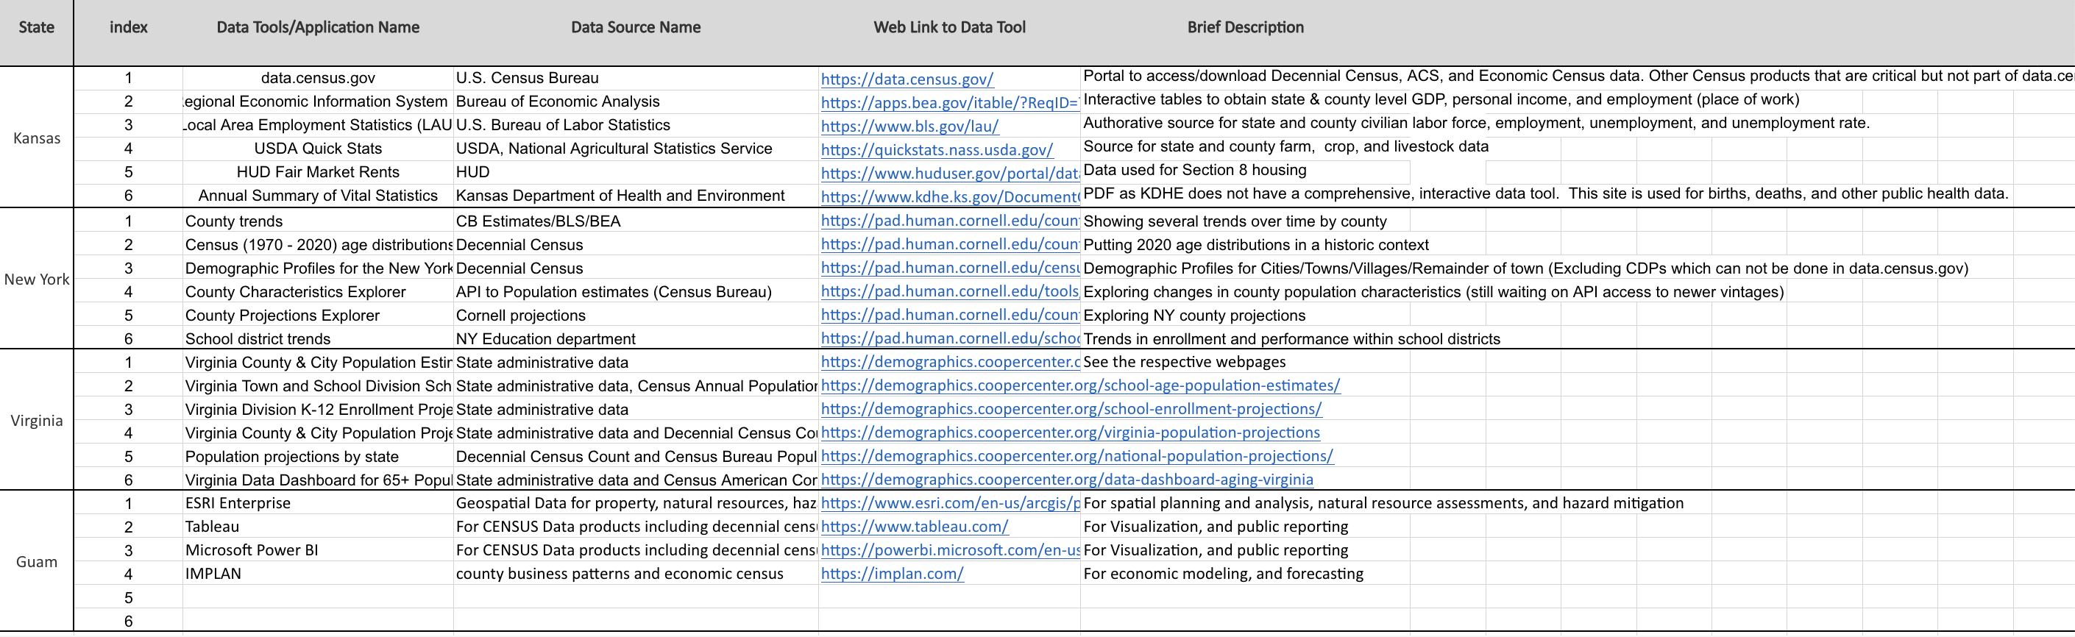
Collected FSCPE Responses
Idea 4: Email survey sent to all 56 FSCPE contacts

Slide 23
Statistics So Far
Idea 4: Email survey sent to all 56 FSCPE contacts
Data Sources:
  U.S. Census Bureau: 9 times
  State administrative data: 5 times
  State Department/projects (Kansas Department of Health and Environment, NY Education department, Cornell projections, etc.): 3 times
  Other sources: Bureau of Economic Analysis, U.S. Bureau of Labor Statistics, National Agricultural Statistics Service …
  Topics:
    Population: 12 times
    Economy: 4 times
    Education: 3 times
    Other topics: housing, agriculture, health ...

Slide 24
Idea 5: Search of Library Databases
  Policy Commons Database
  Policy File Index Database
  State and Local Government Databases
  Policy Map Customer Stories

Slide 25
Questions!

